Slide 1

Mid-Atlantic RDM changes and updates Lou Carr-Harris Northeast Fisheries Science Center June 20th, 2025
1

Slide 2
Overview of discussion
Quick recap of the bioeconomic model
Data and work schedule
Input from the TC
Catch-per-trip
Catch-at-length
Model updates
Dealing with missing standard errors
Incorporating correlation in catch-per-trip
Calibrating the model
Other concerns
Split regulations in a state
February season in Virginia

Slide 3
Recap of the model

Slide 4
Bio-economic model
“Economic” Sub-Model
Simulate angler trips in FY26 under FY26 projected stock structures and proposed regulations
“Biological” Sub-Model
FY26 expected catch-at-length based on:
FY26 projected length structure of the stock
historical recreational selectivity-at-length
Other Inputs
FY26 expected catch-per-trip, trip costs, proposed regulations
Effort
Discards
Harvest
Welfare
Aggregate across trips and compare to harvest target

Slide 5
Bio-economic model
Bio-economic model run for 100 iterations
Each iteration draws from a distribution of:
catch-per-trip
directed trips
catch-at-length adjusted for the projected size distribution of the stock in FY 2026
angler trip costs and demographics
Drawing from distributions captures sampling uncertainty associated with these data
We present the median (50th percentile) of the 100 iterations
Lower and upper confidence intervals are the 10th and 90th percentiles (80% CI)

Slide 6
Bio-economic model data
What we need to know | Data we use
How many trips are likely to occur in a given period in FY2026? | MRIP data on directed trips from the last full FY year of data (FY2024)
How many fish per trip are anglers likely to catch in FY2026? | MRIP data from the most recent 12 waves of MRIP data
What are the likely sizes of the fish anglers will catch in FY2026? | MRIP data on harvest sizes in 2024 MRIP + state VAS data on discard sizes in 2024 Estimates of total harvest and discards in 2024 Projected population numbers-at-length in 2026
Angler trip costs | Most recent NOAA trip expenditure data adjusted for inflation (2017)
Angler demographics (age, # trips taken in the past 12 months) | Most recent year of MRIP fishing effort survey demographic data (2023)
Angler preferences for harvesting/discard sf, bsb, scup | Angler choice experiment survey data from 2022
Notes:
Too much, potential drop

Slide 7
Data and work schedule
Fishing year: | 2023 | 2024 | 2025 |  | 2026
Wave: | 6 | 1 through 6 | 1 through 5 | 6 | 1 through 6
 |  | Calibration year | Update model | Make projections | Projection year
 |  | MRIP catch-per-trip and effort data for calibration
 | MRIP catch-per-trip data for projection
 |  | Catch-at-length data for calibration and to compute baseline rec. selectivity
 |  | Jan 1. 2024 stock assessment data to compute rec. selectivity |  |  | Jan 1. 2026 stock assessment data for projections
 |  | 2024 regulations for calibration | 2025 regulations for status-quo projections

Slide 8
Input from the TC

Slide 9
Catch-per-trip data
Catch-per-trip generated by estimating harvest- and discards-per-trip separately then summing the two
Projected (FY2026) catch-per-trip
We use the last two full years of MRIP data, based on previous discussion with the TC
Catch-per-trip estimation strata
Previous estimation strata was state-month-mode
Current estimation strata state-wave-mode (more certainty)
Is the TC comfortable with these decisions?

Slide 10
Catch-at-length data
To create catch-at-length, we use the following data:
Metric | Source
harvest-at-length | MRIP 2024
total harvest | MRIP 2024
discards-at-length | 2024 data from: NJ VAS CT VAS RI VAS ALS Raw MRIP data
total discards | MRIP 2024

Slide 11
Catch-at-length data aggregation
Discard length data is thin or does not exist by fishing mode/season, across all data sources
Proposed aggregation: region + entire year
Regions:
MA-NY, NJ, DE-NC for fluke and black sea bass
all states for scup
Want to allow for regional heterogeneity in catch length while maintaining suitable sample sizes

Slide 12
2024 catch-at-length data – summer flounder
 | # measured discards |  | # measured harvest
state | by state | by region | by state | by region
MA | 18 | 3365 | 166 | 1103
RI | 444 |  | 315
CT | 993 |  | 154
NY | 1910 |  | 468
NJ | 2266 | 2266 | 1025 | 1025
DE | 62 | 454 | 320 | 493
MD | 391 |  | 70
VA | 1 |  | 103
NC | 0 |  | 0

Slide 13
2024 catch-at-length data - black sea bass
 | # measured discards |  | # measured harvest
state | by state | by region | by state | by region
MA | 1156 | 9970 | 656 | 4410
RI | 3232 |  | 1809
CT | 4482 |  | 642
NY | 1100 |  | 1303
NJ | 749 | 749 | 1608 | 1608
DE | 80 | 1441 | 470 | 2410
MD | 712 |  | 1456
VA | 649 |  | 250
NC | 0 |  | 234

Slide 14
2024 catch-at-length data - scup
 | # measured discards |  | # measured harvest
state | by state | by region | by state | by region
MA | 1192 | 5574 | 4062 | 11493
RI | 601 |  | 1557
CT | 2901 |  | 2002
NY | 868 |  | 3710
NJ | 8 |  | 127
DE | 3 |  | 20
MD | 1 |  | 8
VA | 0 |  | 2
NC | 0 |  | 5

Slide 15
Catch-at-length data aggregation
Does the TC have any guidance or recommendations to the proposed catch-at-length data aggregations?

Slide 16
Model Updates

Slide 17
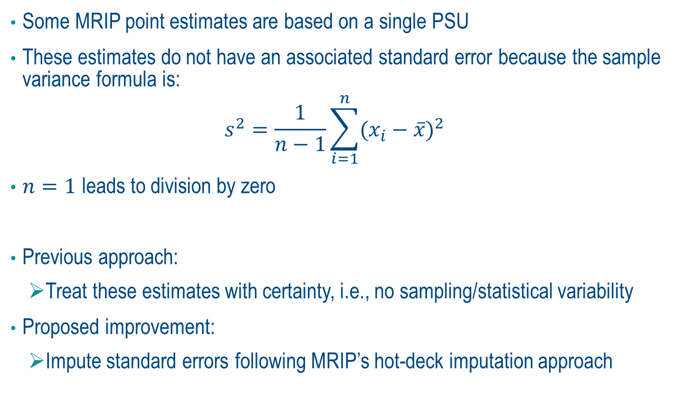
Missing standard errors
Some MRIP point estimates are based on a single PSU
These estimates do not have an associated standard error because the sample variance formula is:
$$s^{2}=\frac{1}{n−1}\sum_{i=1}^{n}{{(x_{i}−\overline{x})}^{2}}$$
$n=1$ leads to division by zero
Previous approach:
Treat these estimates with certainty, i.e., no sampling/statistical variability
Proposed improvement:
Impute standard errors following MRIP’s hot-deck imputation approach

Slide 18
MRIP’s hot-deck imputation approach
Used for intercepted angler trips with landings where both length and weight measurements are missing
Up to five rounds of imputation are conducted in an attempt to fill in missing values:
Current year, wave, sub-region, state, mode, area fished, species.
Current year, half-year, sub-region, state, mode, species.
Current + most recent prior year, wave, sub-region, state, mode, area fished, species.
Current + most recent prior year, sub-region, state, mode, species.
Current + most recent prior year, sub-region, species.

Slide 19
RDM missing SEs
Directed trips
Estimation strata → current year + month + kind-of-day + state + mode
68/411 (16.5%) are missing SEs
Harvest and discards-per-trip
Combined to generate catch-per-trip
Estimation strata → current year + wave + state + mode
59/711 (8.3%) are missing SE’s
Use approach similar to MRIP’s hot-deck approach for filling in missing SEs from higher levels of aggregation

Slide 20
Our imputation approach for filling in missing SEs on estimates of directed trips
Estimation strata is: current year + month + kind-of-day + state + mode
68/411 (16.5%) are missing SEs
Potential imputation rounds:
month + kind-of-day + state + mode, averaged across the last two prior years
month + kind-of-day + state + mode, most recent prior year
month + kind-of-day + state + mode, second-most recent prior year
current year + kind-of-day + state + mode, averaged across the prior month and the next month
current year + kind-of-day + state + mode, prior month
current year + kind-of-day + state + mode, next month
current year + month + kind-of-day + state, averaged across all other fishing modes

Slide 21
Our imputation approach for filling in missing SEs on estimates of directed trips
After imputation, only 7/411 (1.7%) strata cells are missing SE’s
For these cells, I set the SE equal to the mean estimate → implies high uncertainty

Slide 22
Our imputation approach for filling in missing SEs on estimates of harvest- and discards-per-trip (2024)
Estimation strata is: current year + wave + state + mode + species
59/711 (8.3%) are missing SE’s
Potential imputation rounds:
Current year + two-wave period + state + mode
Current year + half-year period + state + mode
Wave | two-wave period | half-year period
1 | 1, 2 | 1, 2, 3
2 | 1, 2 | 1, 2, 3
3 | 3, 4 | 1, 2, 3
4 | 3, 4 | 4, 5, 6
5 | 5, 6 | 4, 5, 6
6 | 5, 6 | 4, 5, 6
Plan to follow the similar approach when computing projected harvest- and discards-per-trip
Is the TC comfortable imputing values for missing standard errors?

Slide 23
Incorporating correlation in catch-per-trip estimates
Previous approach to computing catch-per-trip:
Simulate harvest-per-trip and discards-per-trip separately
Each drawn from MRIP point estimates and SEs
Combine the two to arrive at catch-per-trip
This is appropriate when harvest and discards are independent
However, data show correlation between harvest and discards in many cases

Slide 24
Incorporating correlation in catch-per-trip estimates
Proposed approach:
Estimate correlation between harvest and discards
Use copula modeling to simulate joint distribution of harvest and discards
Keeps marginal distributions unchanged
Captures realistic dependence between outcomes
Produces more informed estimates of trip outcomes (catch, harvest, fishing demand, welfare)
Is the TC comfortable with this approach?

Slide 25
Calibrating the model
Calibrating the model requires generating trips that “look” like trips in the baseline-year (FY2024)
Previous approach:
Simulate trips and adjusted the catch-at-length distribution such that total simulated harvest approximate MRIP estimates
Assumes all fish harvested were legal size, all fish discarded were not legal size
Proposed approach following cod + haddock RDM:
Do not adjust the catch-at-length distribution and instead allow some simulated trips to illegally harvest or voluntary release fish
Carry proportions of trips with these behaviors into the projection year (FY2026) with some adjustments based on the stringency of regulations in FY2026 relative to FY2024
Is the TC comfortable with this approach?

Slide 26
Example of observed sub-legal harvest
I compiled summer flounder harvest length data from MRIP
New Jersey, 2024
Minimum size 18”
Removed observations with imputed lengths
Removed observations from “Delaware Estuary”, which may have been taken where the minimum size was shorter than 18”
Notes:
. di 90/566 = .1590106 below 18”, no imputed, no area=“Delaware Estuary”

Slide 27
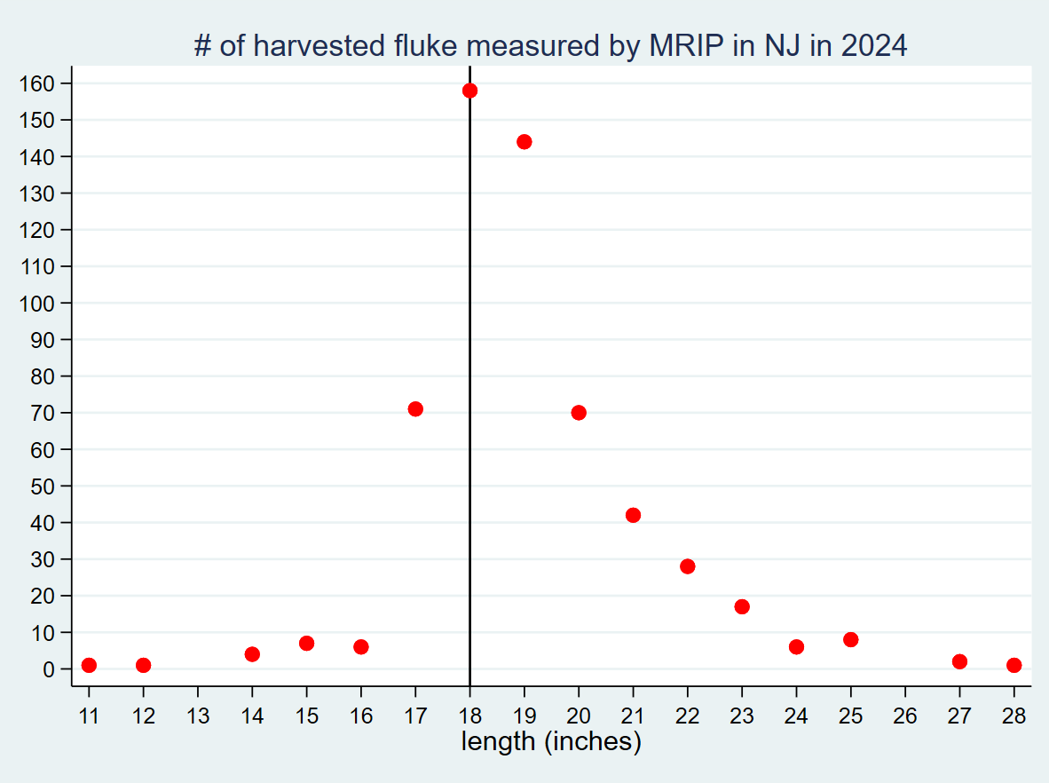
Example of observed sub-legal harvest
90 of 566 (16%) of measured harvest was shorter than 18”
Notes:
. di 90/566 = .1590106 below 18”, no imputed, no area=“Delaware Estuary”

Slide 28
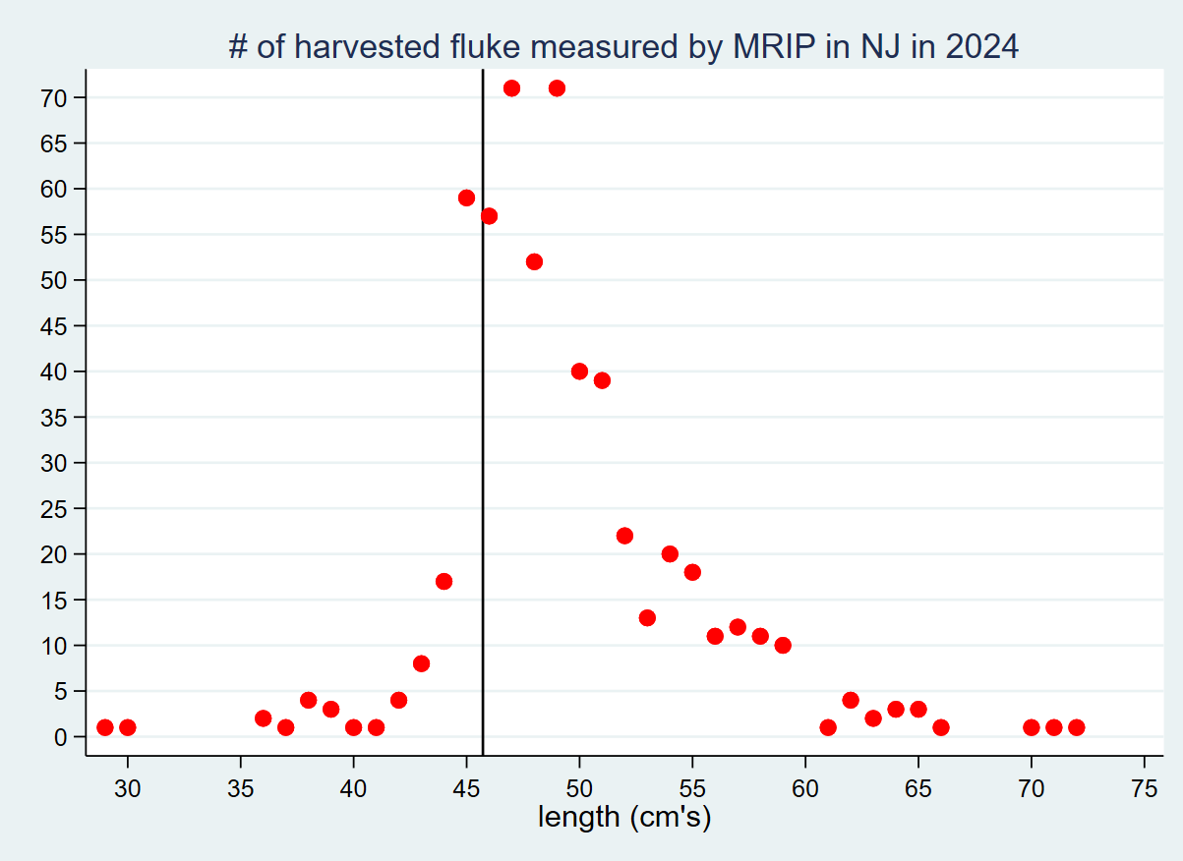
Example of observed sub-legal harvest
102 of 566 (18%) of measured harvest was shorter 45.72 centimeters
Notes:
. di 90/566 = .1590106 below 18”, no imputed, no area=“Delaware Estuary”

Slide 29
Calibrating the model
Is the TC comfortable with the illegal harvest/voluntary release calibration approach?

Slide 30
Other Concerns

Slide 31
Split regulations in a state
Currently we run the model at the state-level
One state has expressed interest in different regulations for different parts of the state
At a minimum, this will increase uncertainty in estimates of directed trips and overall uncertainty in model output
Any guidance or recommendations from the TC?

Slide 32
February season in Virginia
There is a recreational season in February in Virginia
We do not know observed February harvest until at least March
If we only run the model in November/December:
We suggest users evaluate a range of options around expected values of February harvest
Then in March, choose the set of evaluated regulations that most accurately reflected actual February harvest
If we are able to run the model in March or later, we can remove observed February harvest off the top and run the model

Slide 33
Recap of discussion points
Catch-per-trip
Data years for projected 2026 catch-per-trip
Modeling correlation in harvest and discards
Catch-at-length
Aggregating length data across regions
Dealing with missing standard errors
Follow MRIP’s hot-deck imputation approach
Calibrating the model by allowing for illegal harvest/voluntary release
Split regulations in a state
February season in Virginia

